Slide 1

Chapter 23 – Internet Networking

Slide 2
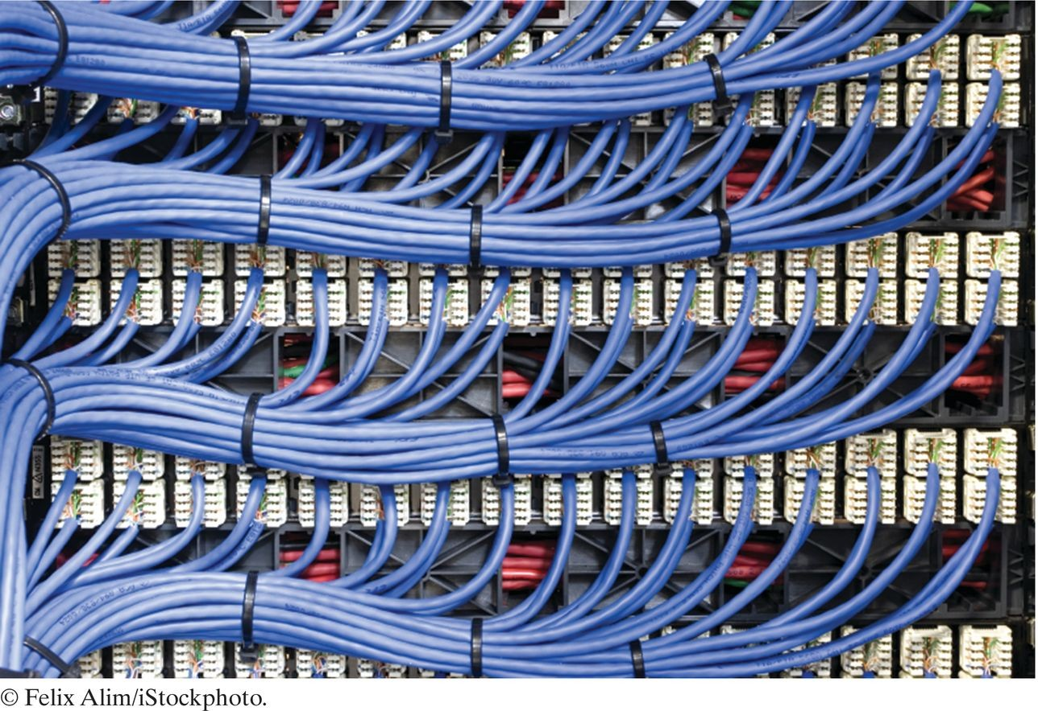
Chapter Goals
To understand the concept of sockets
To send and receive data through sockets To implement network clients and servers
To communicate with web servers and server-side applications through the Hypertext Transfer Protocol (HTTP)

Slide 3
The Internet Protocol
Internet: A worldwide collection of networks, routing equipment, and computers.
Uses a common set of protocols to define how the parties will interact with each other.
Data transmission consists of sending/receiving streams of zeroes and ones along the network connection.

Slide 4
The Internet Protocol
Two types of information:
Application data: information one computer wants to send to another.
Network protocol data: describes how to:
Reach the intended computer.
Check for errors & data loss in the transmission.
Network protocol: rules for protocol data.
Most common: Internet Protocol (IP).
Developed to enable different local area networks to communicate with each other.
Has become the basis for connecting computers around the world together over the Internet.

Slide 5
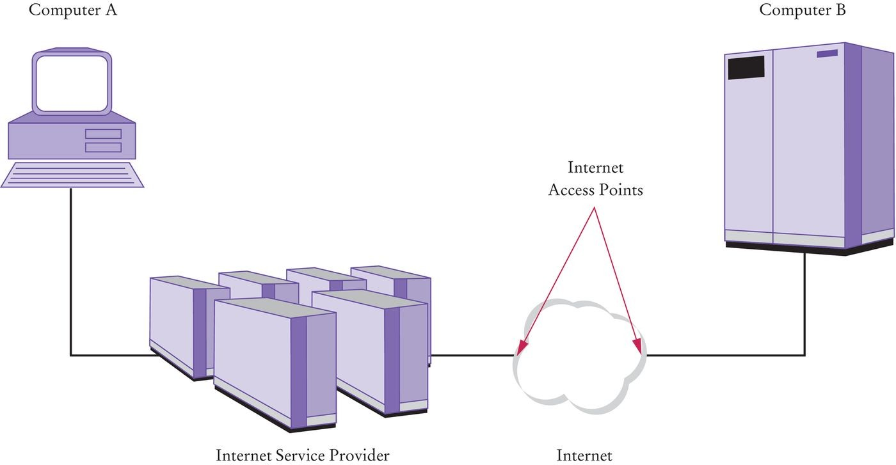
Two Computers Communicating Across the Internet
Figure 1 Two Computers Communicating Across the Internet
A is your home computer.
Connected to an Internet service provider (ISP).
ISP is connected to an Internet access point.
B is on an local area network at XYZ Computers. XYZ has its own Internet access point.
Internet access points are connected by a complex collection of pathways (the Internet).
Message sent from one access point can eventually reach any access point over these pathways.

Slide 6
Destination Address
Data must be marked with a destination address.
In IP, addresses are denoted by a sequence of four numbers.
Each is one byte (a number between 0 and 255). E.g., 130.65.86.66.
To be able to accommodate more devices, IP addresses will be extended to sixteen bytes.
To send data to B, A needs to know B’s Internet address.
A includes that address in the network protocol portion when sending the data.

Slide 7
Domain Naming Service
In addition to an IP address, computers can have an easy-to- remember domain name.
E.g., horstmann.com.
Domain Naming Service (DNS): translates from domain name to IP address.
When A wants to request data from a domain name:
It asks the DNS for the numeric Internet Address.
It includes the numeric address with the request for data.

Slide 8
Packets
IP breaks large chunks of data up into more manageable packets. Each packet is delivered separately.
Each packet in a larger transmission may be sent by a different route.
Packets are numbered.
The recipient reassembles them in the right order.

Slide 9
Transmission Control Protocol
Internet Protocol (IP) does not notify the sender if data is lost or garbled.
This is the job of a higher level protocol Transmission Control Protocol (TCP).
Used by most popular Internet services – WWW & e-mail. Bypassed by “streaming media” services for highest possible throughput.
Most commonly used combination is TCP with IP (TCP/IP).

Slide 10
Port Numbers
One computer can offer multiple services over the Internet.
E.g., both a web server program and a mail server program.
When data are sent to that computer, they need to indicate which program is to receive the data.
IP uses port numbers for this:
Integer between 0 and 65,535.
Sending program must know port number of receiving program. Port number is included in the transmitted network protocol data.

Slide 11
Contents of TCP Packets
Must include:
Internet address of recipient. Port number of recipient.
Internet address of sender. Port number of sender.

Slide 12
Self Check 23.1
What is the difference between an IP address and a domain name?
Answer: An IP address is a numerical address, consisting of four or sixteen bytes. A domain name is an alphanumeric string that is associated with an IP address.

Slide 13
Self Check 23.2
Why do some streaming media services not use TCP?
Answer: TCP is reliable but somewhat slow. When sending sounds or images in real time, it is acceptable if a small amount of the data is lost. But there is no point in transmitting data that is late.

Slide 14
Application Level Protocols
TCP/IP mechanism establishes an Internet connection between two ports on two computers.
Each Internet application has its own application protocol. Describes how data for that application are transmitted.

Slide 15
Hypertext Transfer Protocol (HTTP)
Application protocol used by the World Wide Web.
A web address is called a Uniform Resource Locator (URL). You type a URL into the address window of your browser.
E.g., http://horstmann.com/index.html.

Slide 16
Browser Steps in Loading URL
Examines the part of the URL between the double slash and the first single slash (horstmann.com).
This identifies the computer to which you want to connect.
Because it contains letters, this part of the URL is a domain name, not an IP address.
Browser sends request to a DNS server to obtain IP address for
horstmann.com.
From http: prefix, deduces protocol is HTTP.
Uses port 80 by default.
Establishes a TCP/IP connection to port 80 at IP address obtained in Step 1.

Slide 17
Browser Steps in Loading URL
Deduces from the /index.html that you want to see the file
/index.html and sends this request formatted as an HTTP command through the established connection.
GET /index.html HTTP/1.0 Host: horstman.com
blank line
Web server running on computer whose IP Address was obtained above receives the request.
It decodes the request.
It fetches the file /index.html.
It sends the file back to the browser on your computer.

Slide 18
Browser Steps in Loading URL
Browser displays contents of the file:
Since this file is an HTML file, it translates the HTML codes into fonts, bullets, etc.
If the file contains images, it makes more GET requests through the same connection.

Slide 19
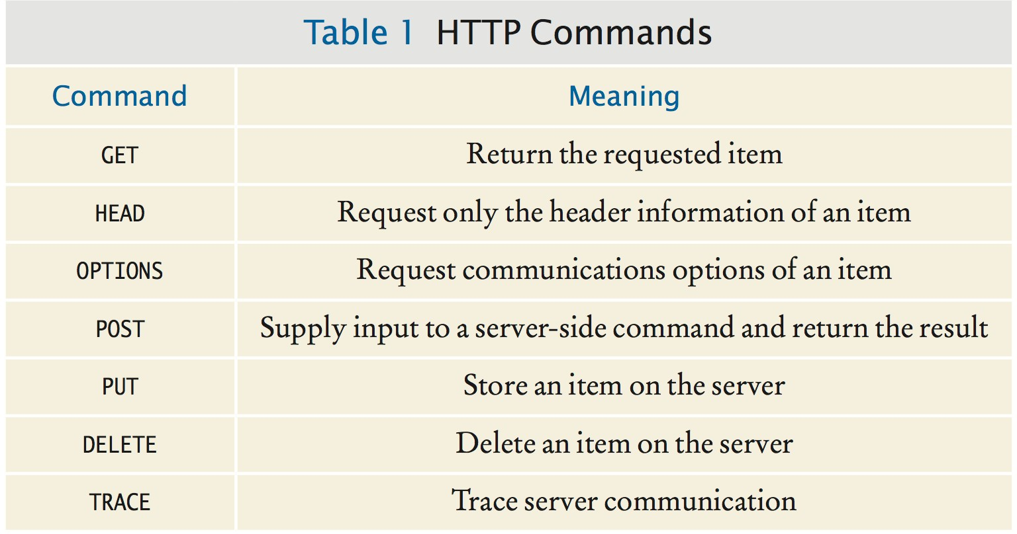
HTTP Commands

Slide 20
Telnet
Telnet program allows you to:
Type characters to send to a remote computer.
View the characters that the remote computer sends back.
It is a useful tool to establish test connections with servers.
You can imitate the browser connection by using a dialog box or typing at the command line:
telnet horstmann.com 80

Slide 21
Telnet
After Telnet starts, type the following without using backspace:
GET / HTTP/1.0
Host: horstmann.com
Then press the Enter key twice.
The server responds to the request with the file. Telnet is not a browser.
It does not understand HTML tags so it just displays everything it was sent.

Slide 22
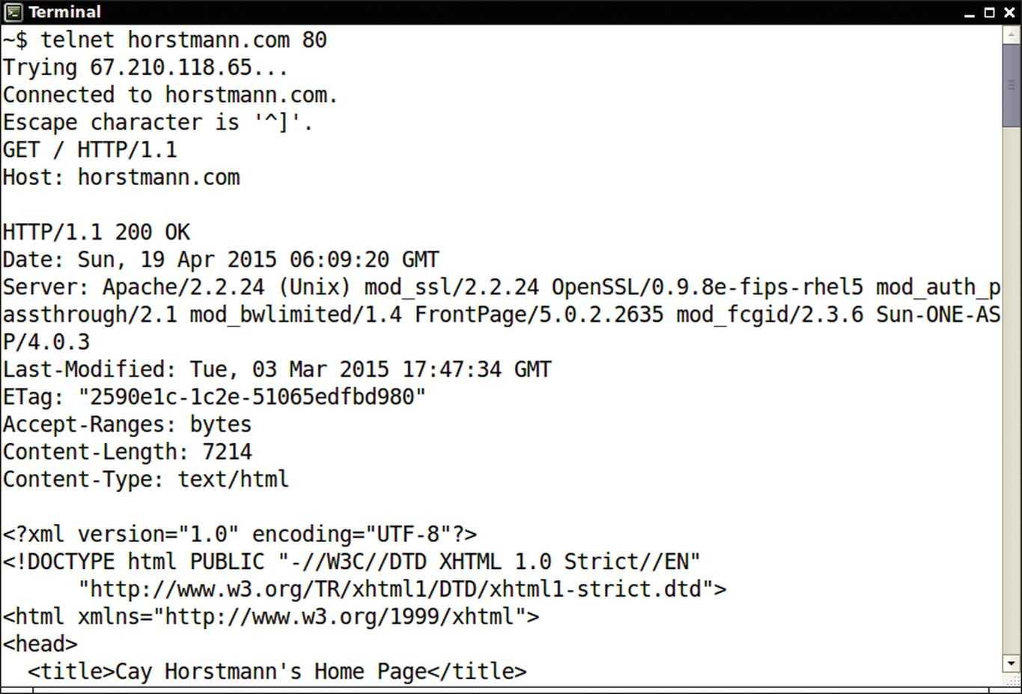
Telnet
Figure 2 Using Telnet to Connect to a Web Server

Slide 23
HTTP and HTML
Do not confuse HTTP with HTML.
HTML is a document format that describes the structure of a document.
HTTP is a protocol that describes the command set for web server requests.
Web browsers:
Know how to display HTML documents. And how to issue HTTP commands.
Web servers:
Know nothing about HTML.
Merely understand HTTP and know how to fetch the requested items.

Slide 24
Application Level Protocols
HTTP is one of many application protocols in use on the Internet. Another commonly used protocol is the Post Office Protocol (POP). POP is used to download received messages from e-mail servers.
To send messages, you use another protocol: Simple Mail Transfer Protocol (SMTP).

Slide 25
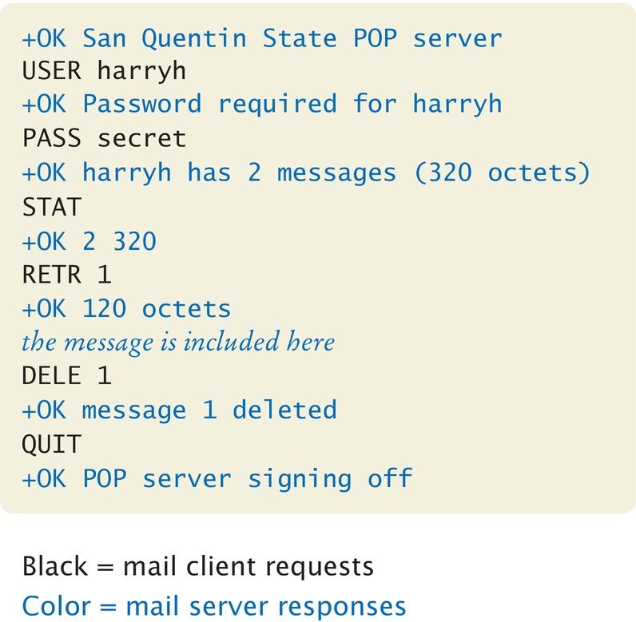
Sample POP Session
Figure 3 A Sample POP Session

Slide 26
Self Check 23.3
Why don’t you need to know about HTTP when you use a web browser?
Answer: The browser software translates your requests (typed URLs and mouse clicks on links) into HTTP commands that it sends to the appropriate web servers.

Slide 27
Self Check 23.4
Why is it important that you don’t make typing errors when you type HTTP commands in Telnet?
Answer: Some Telnet implementations send all keystrokes that you type to the server, including the backspace key. The server does not recognize a character sequence such as G W Backspace E T as a valid command.

Slide 28
A Client Program
Task: write a Java program that:
Establishes a TCP connection to a server. Sends a request to the server.
Prints the response.

Slide 29
Sockets
A socket is an object that encapsulates a TCP/IP connection. There is a socket on both ends of a connection.
Create a socket in a Java program:
Socket s = new Socket(hostname, portnumber);
Connect to the HTTP port of server, horstmann.com:
final int HTTP_PORT = 80;
Socket s = new Socket("horstmann.com", HTTP_PORT);
If it can’t find the host, the Socket constructor throws an
UnknownHostException.

Slide 30
Input and Output Streams
Use the input and output streams attached to the socket to communicate with the other endpoint.
Obtain the input and output streams:
InputStream instream = s.getInputStream(); OutputStream outstream = s.getOutputStream();
When you send data to outstream, the socket forwards them to the server.
The socket catches the server’s response and you can read it through instream.
When you are done communicating with the server, close the socket.
Best done using a try-with-resources statement:
try (Socket s = . . . )
{
. . .
} // s.close() called here

Slide 31
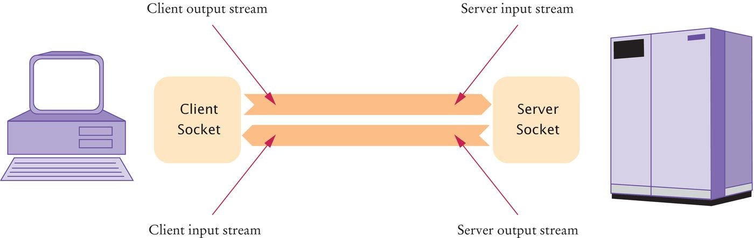
Client and Server Sockets
Figure 4 Client and Server Sockets

Slide 32
Scanners and Writers
InputStream and OutputStream send and receive bytes. To send and receive text, use a scanner and a writer:
Scanner in = new Scanner(instream); PrintWriter out = new PrintWriter(outstream);
A PrintWriter buffers the characters and only sends when the buffer is full.
Buffering increases performance.
When sending a command, you want the whole command to be sent now.
Flush the buffer manually:
out.print(command); out.flush();

Slide 33
WebGet Program
Program lets you retrieve any item from a web server. Specify the host and item (separated by a space) from the command line; e.g.:
java WebGet horstmann.com /
The "/" denotes the root page of the web server that listens to port 80 of horstmann.com.
Program:
Establishes a connection to the host. Sends a GET command to the host.
Receives input from the server until the server closes its connection.

Slide 34
section_3/WebGet.java
import java.io.InputStream;
import java.io.IOException;
import java.io.OutputStream;
import java.io.PrintWriter;
import java.net.Socket;
import java.util.Scanner;
7
8
9
10
11
12
13
14
15
16
17
18
19
20
21
22
23
24
25
/**
This program demonstrates how to use a socket to communicate with a web server. Supply the name of the host and the
resource on the command-line, for example java WebGet horstmann.com index.html
*/
public class WebGet
{
public static void main(String[] args) throws IOException
{
// Get command-line arguments
String host; String resource;
if (args.length == 2)
{
host = args[0];
Program Run:
Getting / from horstmann.com HTTP/1.1 200 OK
Date: Thu, 09 Apr 2015 14:15:04 GMT
Server: Apache/1.3.41 (Unix) Sun-ONE-ASP/4.0.2
...
Content-Length: 6654

Slide 35
Content-Type: text/html
<html>
<head><title>Cay Horstmann's Home Page</title></head>
<body>
<h1>Welcome to Cay Horstmann's Home Page</h1>
...
</body>
</html>

Slide 36
Self Check 23.5
What happens if you call WebGet with a nonexistent resource, such as wombat.html at
horstmann.com?
Answer: The program makes a connection to the server, sends the
GET request, and prints the error message that the server returns.

Slide 37
Self Check 23.6
How do you open a socket to read e-mail from the POP server at e-mail.sjsu.edu?
Answer:
Socket s = new Socket("e-mail.sjsu.edu", 110);

Slide 38
A Server Program
Task: write a Java program that:
Enables clients to manage a set of bank accounts in a bank.
When you develop a server application, you need an application- level protocol.
Client can use this protocol to interact with the server.

Slide 39
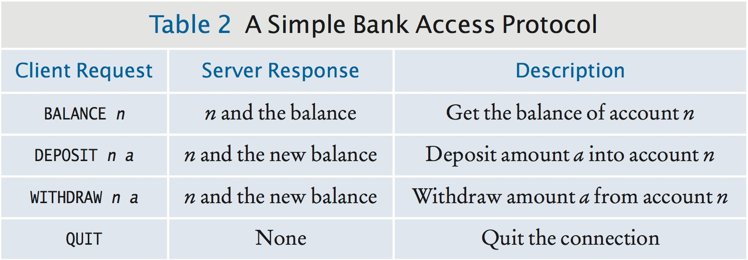
A Simple Bank Access Protocol

Slide 40
Server Socket
Server waits for clients to connect on a certain port.
We choose 8888.
To listen for incoming connections, use a server socket. To construct a server socket, provide the port number:
ServerSocket server = new ServerSocket(8888);
Use the accept method to wait for client connection and obtain a socket:
Socket s = server.accept();
BankService service = new BankService(s, bank);

Slide 41
BankService Program
Program carries out the service. Implements the Runnable interface.
Its run method will be executed in each thread that serves a client connection.
run gets a scanner and writer from the socket, then executes:
public void doService() throws IOException
{
while (true)
{
if (!in.hasNext()) { return; } String command = in.next();
if (command.equals("QUIT")) { return; } executeCommand(command);
}
}

Slide 42
executeCommand Method
Processes a single command.
If the command is DEPOSIT, it carries out the deposit.
int account = in.nextInt(); double amount = in.nextDouble(); bank.deposit(account, amount);
WITHDRAW is handled in the same way.
After each command, the account number and new balance are sent to the client:
out.println(account + " " + bank.getBalance(account));

Slide 43
Threads
doService returns to the run method if the client closed the connection or the command equals QUIT.
Then run closes the socket and exits.
How can we support multiple simultaneous clients?
Spawn a new thread whenever a client connects. Each thread is responsible for serving one client.

Slide 44
Threads
BankService implements Runnable; so, it can start a thread using start on a Thread object.
The thread dies when the client quits or disconnects and the run
method exits.
In the meantime, BankServer loops back to accept the next connection:
while (true)
{
Socket s = server.accept();
BankService service = new BankService(s, bank); Thread t = new Thread(service);
t.start();
}
The server program never stops.
When you are done running the server, you need to kill it.

Slide 45
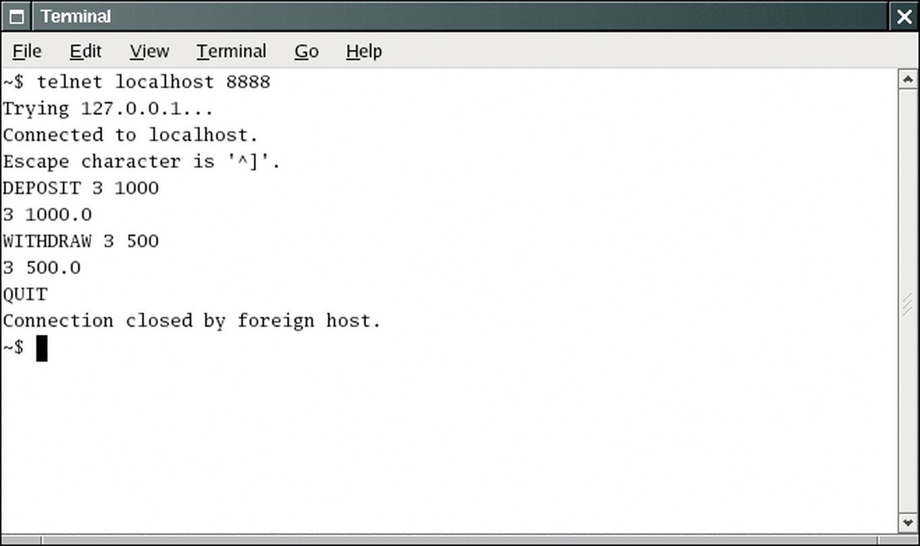
BankServer Communication
Figure 5 Using the Telnet Program to Connect to the Bank Server

Slide 46
section_4/BankServer.java
import java.io.IOException;
import java.net.ServerSocket;
import java.net.Socket;
4
5
6
7
8
9
10
11
12
13
14
15
16
17
18
19
20
21
22
23
24
25
26
27
28
29 }
/**
A server that executes the Simple Bank Access Protocol.
*/
public class BankServer
{
public static void main(String[] args) throws IOException
{
final int ACCOUNTS_LENGTH = 10;
Bank bank = new Bank(ACCOUNTS_LENGTH); final int SBAP_PORT = 8888;
ServerSocket server = new ServerSocket(SBAP_PORT); System.out.println("Waiting for clients to connect...");
while (true)
{
try (Socket s = server.accept())
{
System.out.println("Client connected."); BankService service = new BankService(s, bank); Thread t = new Thread(service);
t.start();
}
}
}

Slide 47
section_4/BankService.java
import java.io.InputStream;
import java.io.IOException;
import java.io.OutputStream;
import java.io.PrintWriter;
import java.net.Socket;
import java.util.Scanner;
7
8
9
10
11
12
13
14
15
16
17
18
19
20
21
22
23
24
25
26
27
28
29
30
31
32
33
34
35
/**
Executes Simple Bank Access Protocol commands from a socket.
*/
public class BankService implements Runnable
{
private Socket s; private Scanner in; private PrintWriter out; private Bank bank;
/**
Constructs a service object that processes commands from a socket for a bank.
@param aSocket the socket
@param aBank the bank
*/
public BankService(Socket aSocket, Bank aBank)
{
s = aSocket; bank = aBank;
}
public void run()
{
try
{
in = new Scanner(s.getInputStream());

Slide 48
section_4/Bank.java
1 /**
2 A bank consisting of multiple bank accounts.
3 */
4 public class Bank
5 {
6 private BankAccount[] accounts;
7
8
9
10
11
12
13
14
15
16
17
18
19
20
21
22
23
24
25
26
27
28
29
30
31
32
33
34
/**
Constructs a bank account with a given number of accounts.
@param size the number of accounts
*/
public Bank(int size)
{
accounts = new BankAccount[size];
for (int i = 0; i < accounts.length; i++)
{
accounts[i] = new BankAccount();
}
}
/**
Deposits money into a bank account.
@param accountNumber the account number
@param amount the amount to deposit
*/
public void deposit(int accountNumber, double amount)
{
BankAccount account = accounts[accountNumber]; account.deposit(amount);
}
/**
Withdraws money from a bank account.
@param accountNumber the account number

Slide 49
section_4/BankClient.java
import java.io.InputStream;
import java.io.IOException;
import java.io.OutputStream;
import java.io.PrintWriter;
import java.net.Socket;
import java.util.Scanner;
7
8
9
10
11
12
13
14
15
16
17
18
19
20
21
22
23
24
25
26
/**
This program tests the bank server.
*/
public class BankClient
{
public static void main(String[] args) throws IOException
{
final int SBAP_PORT = 8888;
try (Socket s = new Socket("localhost", SBAP_PORT))
{
InputStream instream = s.getInputStream(); OutputStream outstream = s.getOutputStream(); Scanner in = new Scanner(instream); PrintWriter out = new PrintWriter(outstream);
String command = "DEPOSIT 3 1000\n"; System.out.print("Sending: " + command); out.print(command);
out.flush();
Program Run:
Sending: DEPOSIT 3 1000
Receiving: 3 1000.0
Sending: WITHDRAW 3 500
Receiving: 3 500.0 Sending: QUIT

Slide 50
Self Check 23.7
Why didn’t we choose port 80 for the bank server?
Answer: Port 80 is the standard port for HTTP. If a web server is running on the same computer, then one can’t open a server socket on an open port.

Slide 51
Self Check 23.8
Can you read data from a server socket?
Answer: No, a server socket just waits for a connection and yields a regular Socket object when a client has connected. You use that socket object to read the data that the client sends.

Slide 52
URL Connections
Java library class URLConnection provides convenient support for the HTTP protocol.
First, construct a URL object from a URL starting with the http or
ftp prefix:
URL u = new URL("http://horstmann.com/index.html");
Then use the URL's openConnection method to get the
URLConnection:
URLConnection connection = u.openConnection();
Call the getInputStream method to obtain an input stream:
InputStream instream = connection.getInputStream();
You can turn the stream into a scanner in the usual way.

Slide 53
HTTP Commands
Client request format:
command
request properties blank line
blank line separates the command and its request properties from the input data.
E.g.,
GET item HTTP/1.1 Host: hostname blank line
E.g.,
GET item HTTP/1.1 Host: hostname
IF-Modified-Since: date
blank line

Slide 54
URLConnection Class
Has methods to set request properties:
connection.setIfModifiedSince(date);
Set the request properties before calling getInputStream.
The URLConnection class sends to the web server all the request properties that are set.

Slide 55
Server Response
Server response:
status line containing response code response parameters
blank line requested data
E.g.,
HTTP/1.1 200 OK
Date: Tue, 24 Aug 2012 00:15:48 GMT
Server: Apache/1.3.3 (Unix)
Last-Modified: Sat, 26 Jun 2012 20:53:38 GMT
Content-Length: 4813 Content-Type: text/html blank line
requested data

Slide 56
Server Response
Normally, you don’t see the response code, in this case: 200 OK. You may have run across bad links and see a page that contains response code 404 Not Found.

Slide 57
Retrieving Response Code and Message
Cast the URLConnection object to the HttpURLConnection
subclass.
Get the response code with getResponseCode.
Get the response message with getResponseMessage:
HttpURLConnection httpConnection = (HttpURLConnection) connection;
int code = httpConnection.getResponseCode();
// e.g., 404
String message = httpConnection.getResponseMessage();
// e.g., "Not found"

Slide 58
Retrieving Other Response Information
Content length:
int length = connection.getContentLength();
Content type:
String type = connection.getContentType();

Slide 59
section_5/URLGet.java
import java.io.InputStream;
import java.io.IOException;
import java.io.OutputStream;
import java.io.PrintWriter;
import java.net.HttpURLConnection;
import java.net.URL;
import java.net.URLConnection;
import java.util.Scanner;
9
10
11
12
13
14
15
16
17
18
19
20
21
22
23
24
25
/**
This program demonstrates how to use a URL connection to communicate with a web server. Supply the URL on the command line, for example
java URLGet http://horstmann.com/index.html
*/
public class URLGet
{
public static void main(String[] args) throws IOException
{
// Get command line arguments
String urlString;
if (args.length == 1)
{
urlString = args[0];
Program Run:
Using http://horstmann.com/
200 OK
<html>
<head><title>Cay Horstmann's Home Page</title></head>
<body>
<h1>Welcome to Cay Horstmann's Home Page</h1>
...
</body>
</html>

Slide 60
Self Check 23.9
Why is it better to use a URLConnection instead of a socket when reading data from a web server?
Answer: The URLConnection class understands the HTTP protocol, freeing you from assembling requests and analyzing response headers.

Slide 61
Self Check 23.10
What happens if you use the URLGet program to request an image (such as
http://horstmann.com/cay-tiny.gif)?
Answer: The bytes that encode the images are displayed on the console, but they will appear to be random gibberish.

